Slide 1
iCARe An Intelligent Car Budgeting Assistant
Group 4 Members:
Muniyandi Vanitha, A0249302L
Sim Yuh Fan, A0249251E
Tan Gek Teng, A0030151E
Teoh Jeng Wei, A0093899B

Slide 2
Agenda
Project Goals
Project Timeline
Wireframe Design
System Architecture
Data Collection and Preparation
Data Exploration
Dimension Reduction with PCA
Forecasting Models
Next Steps

Slide 3
Project Goals
Problem Statement
In recent years, the COE prices in Singapore have been skyrocketing due to high inflation, low COE quotas and high demand for private vehicles. Predicting future COE prices in this environment is not an easy task and the fear of increasing prices induces the average consumer to make potentially rash financial decisions.
How are we going to solve the problem?
Our objective is to build an application which will predict future COE prices and recommends a list of cars based on the user's budget and target purchase date to help users to make informed financial decisions.
Scope
There are 5 COE categories - CAT A,B,C,D,E. However, for this project, we will be focussing on CAT A COE price forecasting as a MVP

Slide 4
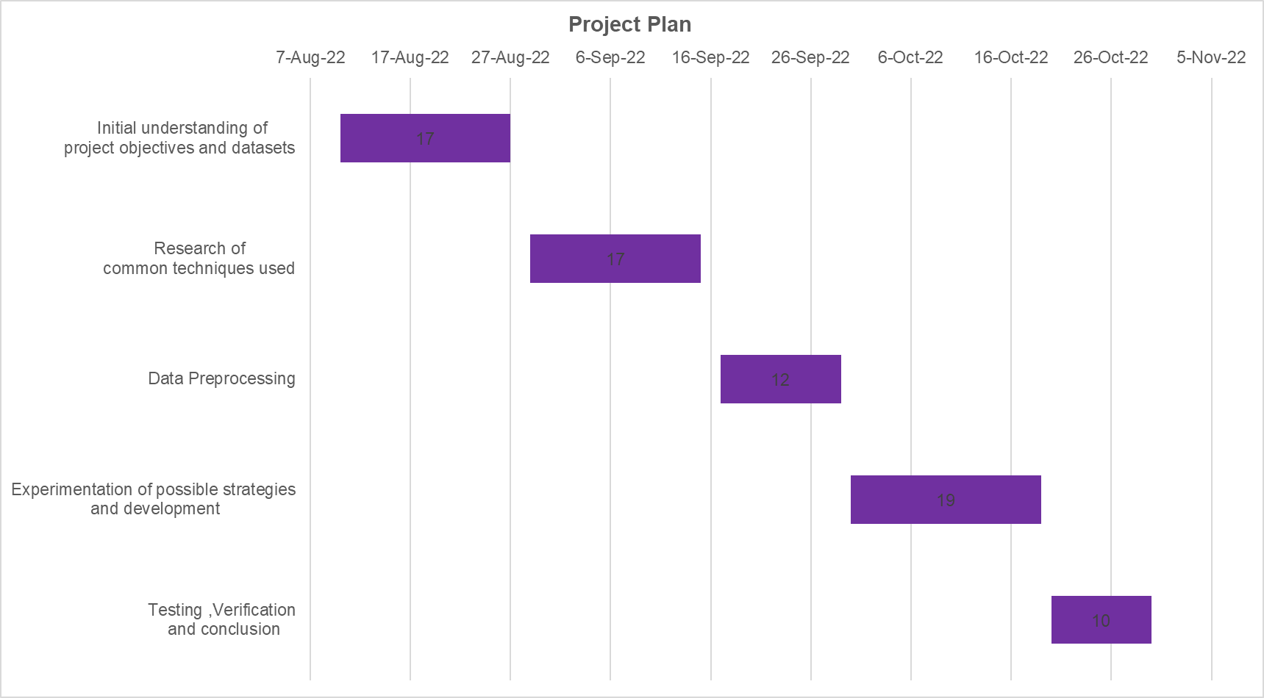
Project Timeline

Slide 5
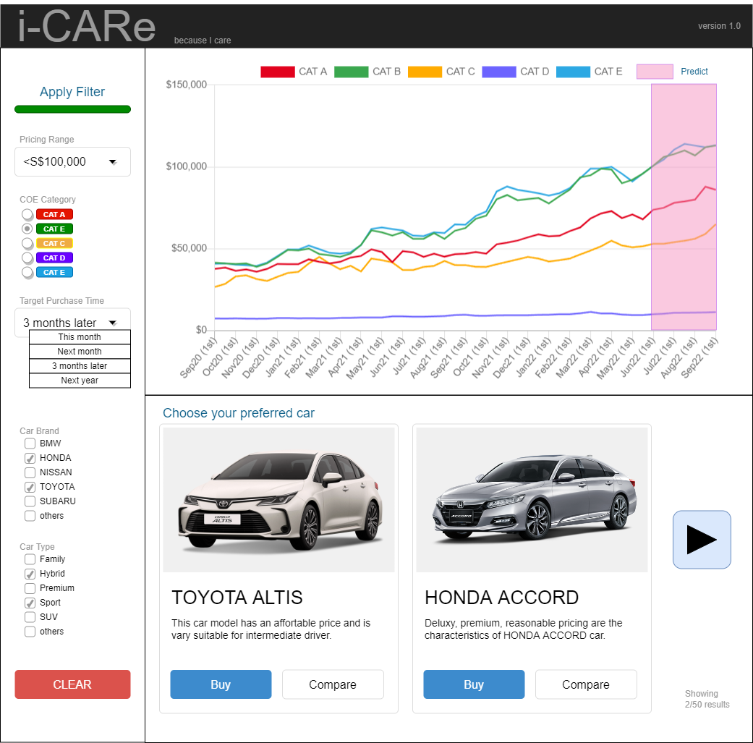
Wireframe design
3 components
1) COE price forecast
2) User input
3) List of recommended cars

Slide 6
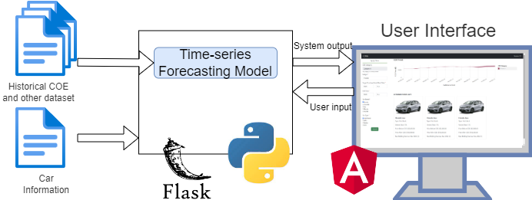
System Architecture

Slide 7
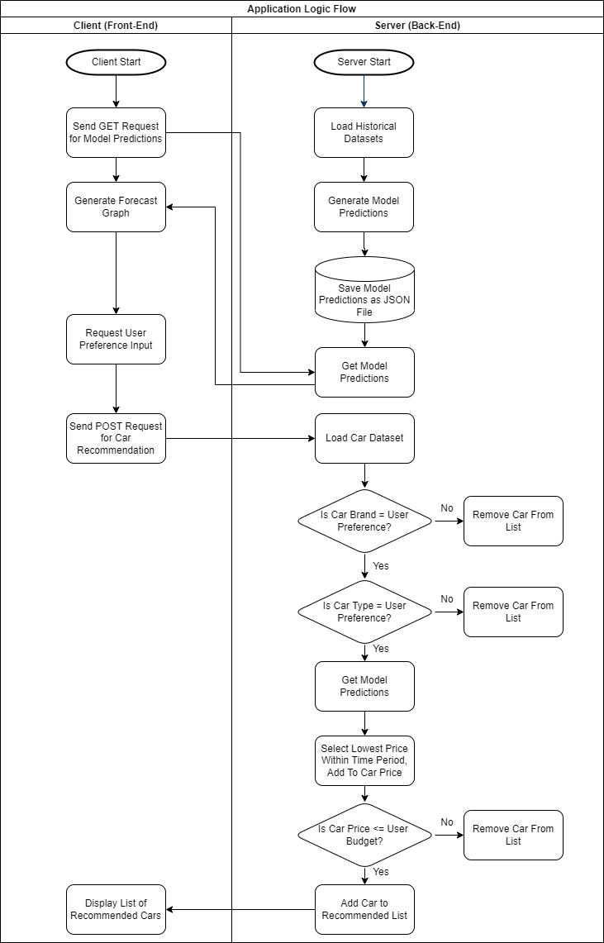
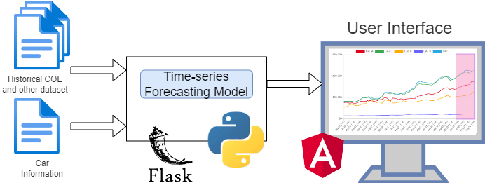
System Architecture and Logic Flow

Slide 8
Time Series Forecasting Models
Performance of time series forecasting models is highly dependent on the nature of the time series dataset
No reliable method of determining the best model to use for a given time series dataset.
Thus, we need to train different forecasting models on both univariate and multivariate datasets

Slide 9
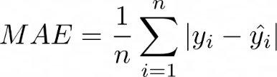
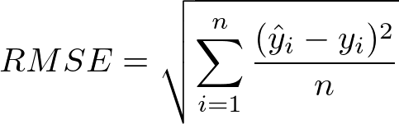
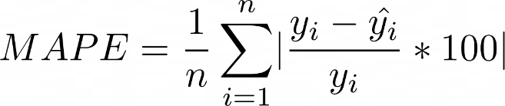
Model Performance Evaluation Metrics
Mean Absolute Error (MAE)
Root Mean Square Error (RMSE)
Mean Absolute Percentage Error (MAPE)
Notes:
https://towardsdatascience.com/time-series-forecast-error-metrics-you-should-know-cc88b8c67f27

Slide 10
Univariate Machine Learning

Slide 11
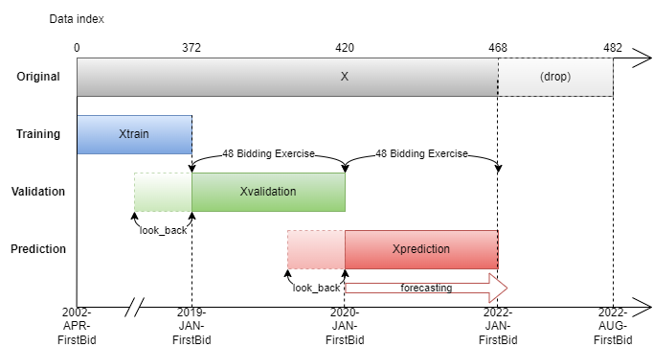
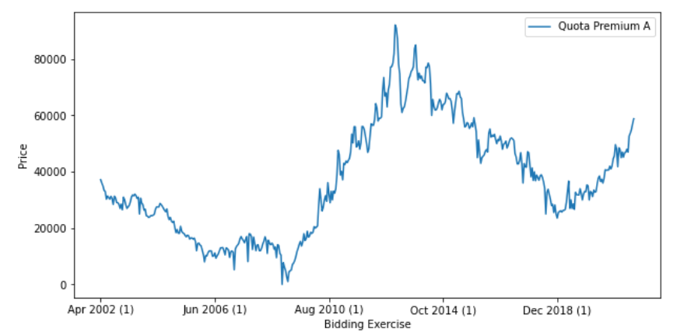
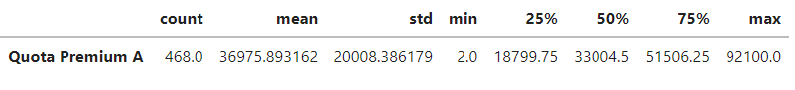
Univariate Data Preparation and Exploration
Dataset | Description | Frequency | Year
COE | COE Bidding Result for Vehicle Category A to E | Bi-monthly | 2002 – 2022
*For this project, we have decided to narrow the scope to only look at data points corresponding to the Category A as a Proof-of-Concept for the Minimum Viable Product.

Slide 12
Univariate ARIMA
Baseline model
The Autoregressive Integrated Moving Average (ARIMA) model is a combination of the differenced autoregressive model with the moving average model.
An ARIMA model is characterized by 3 terms: p, d, q
p is the order of the AR term
q is the order of the MA term
d is the number of differencing required to make the time series stationary
Training the model to forecast 2 years ahead -> the last 48 data points are taken from the time-series to be used as a testing set while the model is trained on the preceding 420 data points
Notes:
The Autoregressive Integrated Moving Average (ARIMA) model is a statistical model which is combination of the differenced autoregressive model with the moving average model. An ARIMA model can be characterized by 3 terms: p, d, q, where p corresponds to the order of the Auto-Regressive term, q corresponds to the order of the Moving Average term and d is the number of differencing required to make the time series stationary.
Firstly, we need to determine a set of values for p, d and q to create the baseline ARIMA model.
ARIMA Definition
https://www.sciencedirect.com/topics/mathematics/autoregressive-integrated-moving-average
https://www.machinelearningplus.com/time-series/arima-model-time-series-forecasting-python/

Slide 13
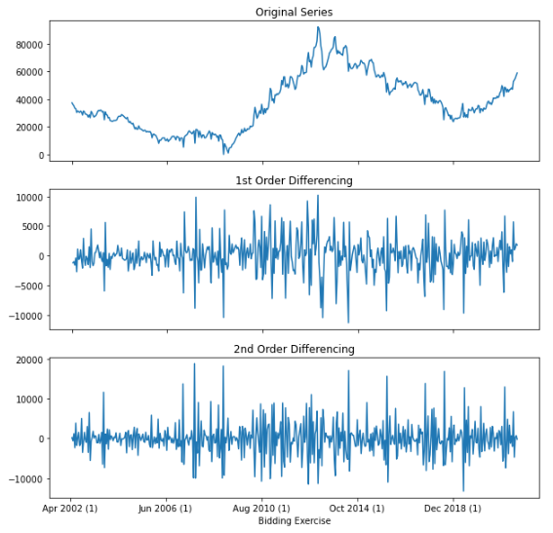
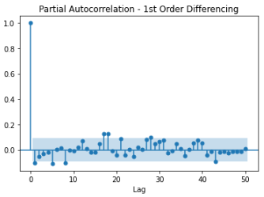
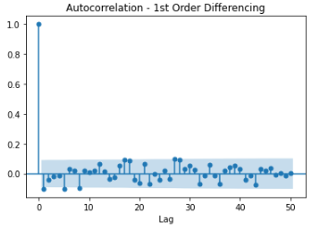
Univariate ARIMA
Estimating the values of p, d, q for COE CAT A ARIMA model
PACF lag 1 is significant since is below the significance line => p =1
2 of the ACF lags exceeded the significance line => q =2
Time-series data becomes stationary after 2 times of differencing => d=2
Notes:
As observed from the Partial Autocorrelation graph, PACF lag 1 is significant since is below the significance line. Therefore, p=1 is selected.
As observed from the Autocorrelation graph, 2 of the ACF lags exceeded the significance line. Hence, q=2 is selected.
As observed from the plots shown above, the original time-series data for COE CAT A prices only becomes stationary after 2 orders of differencing, which is why we have selected d=2
ARIMA Definition
https://www.sciencedirect.com/topics/mathematics/autoregressive-integrated-moving-average
https://www.machinelearningplus.com/time-series/arima-model-time-series-forecasting-python/

Slide 14
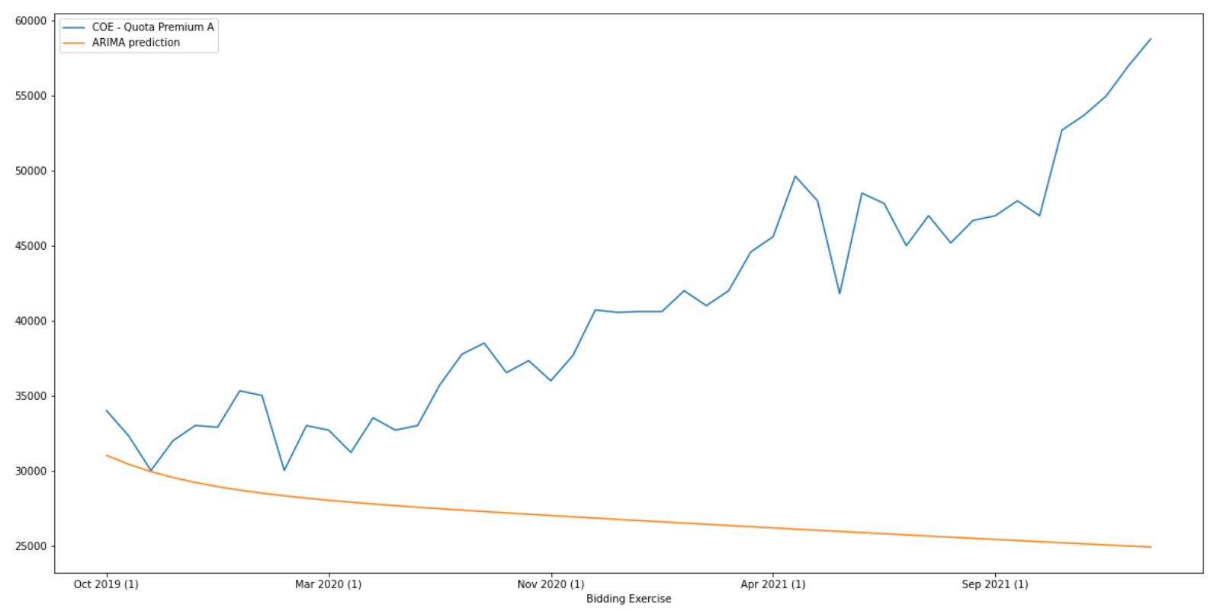
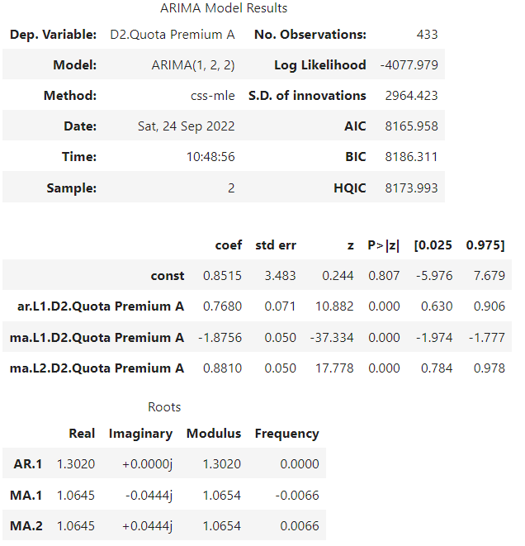
Univariate ARIMA
Parameters: p=1, d=2, q=2
Metric | Value
MAE | 21174.30
RMSE | 17583.81
MAPE | 29.56%
Forecast trend is in the wrong direction
Attempts to refine the ARIMA model by trying out different combinations of p, d, q values did not yield any improvements
Set of values of (p,d,q) is good:
coef for AR1, MA1, MA2 are significantly high
P>|z| << 0.05 for all 3 terms
Notes:
Fitting the ARIMA model using the p, d and q values determined from the previous section, the coefficients for the respective Auto Regression and Moving Average terms are significant and the P z value for all three terms are significantly smaller than 0.05 which indicates a theoretical good fit. However, the Forecast trend is in the opposite direction of the actual trend. Attempts to improve on the ARIMA model involves trying different combinations of p,d and q but that did not yield any improvements

Slide 15
Univariate SARIMA
If a time series, has seasonal patterns, then you need to add seasonal terms and it becomes SARIMA, short for ‘Seasonal ARIMA’.
A SARIMA model is characterized by 7 terms: p, d, q, P, D, Q and s
p and seasonal P is the order of the AR term
q and seasonal Q is the order of the MA term
d and seasonal D is the number of differencing required to make the time series stationary
s is the seasonal length in the data
Let P=p, Q=q and D=d
s can be estimated by determining the interval between the ACF lags that are significant -> there is a significant negative lag at 1 and 4 -> indicate that s=4
Notes:
To improve on the base ARIMA model, we tried to introduce seasonal terms by using the SARIMA model, short for Seasonal ARIMA. For SARIMA, there are 4 additional terms: seasonal P, Q, D and s. By default, we set the seasonal components P, Q and D to be the same value as p, q and d. s can be estimated by determining the interval between the ACF lags that are significant. Since there is a significant negative lag at 1 and 4, we selected s=4.

Slide 16
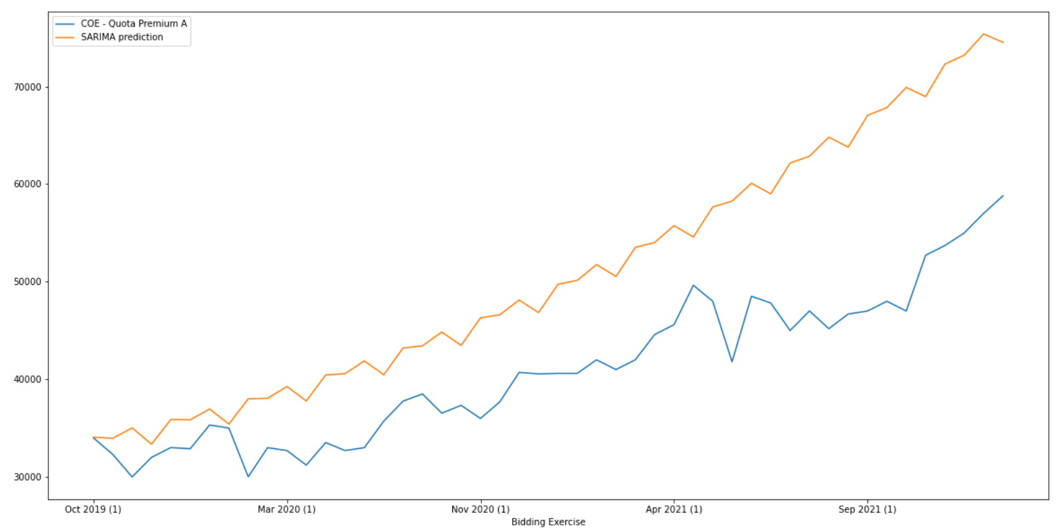
Univariate SARIMA
Parameters: p=1, d=2, q=2, P=1, D=2, Q=2, s=4
Metric | Value
MAE | 11439.19
RMSE | 9810.83
MAPE | 22.76%
Notes:
Looking at the performance metrics of the SARIMA model, we observe that the SARIMA model has a significantly lower MAPE of 22.76% than ARIMA model which has a MAPE of 29.56%, which means that SARIMA is significantly better than ARIMA. This is also corroborated by the forecast vs actual graph.

Slide 17
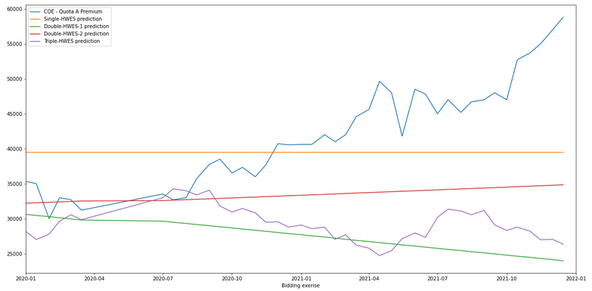
Univariate Holt-Winter
Parameters: seasonal_period=24
Metric | Value
MAE | 6423.998899
RMSE | 7685.801557
MAPE | 15.44%
Notes:
HWES1 has the best MAPE with 15.44% but still under expectation because it is a straight line and error is very large with more than 10%.

Slide 18
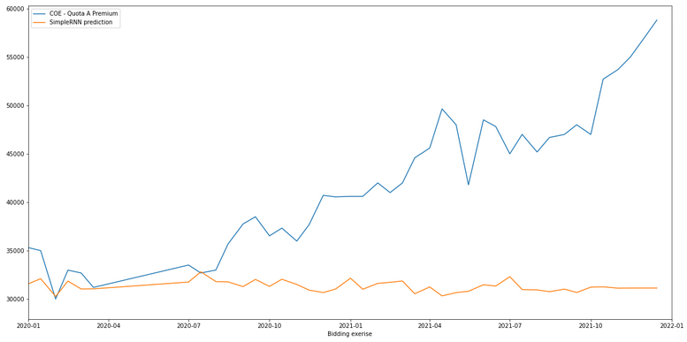
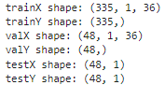
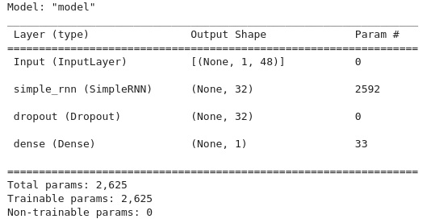
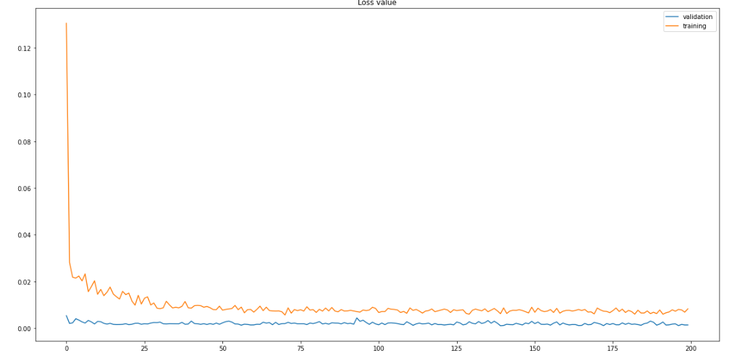
Univariate Simple RNN
Optimized segment parameters:
length = 36,
dist = 36
look_back/width = 48
No. of data points to forecast = 48
Metric | Value
MAE | 10009.39
RMSE | 12074.975154
MAPE | 21.37%
Method of multi-step forecasting: Forward walking (one step at a time)

Slide 19
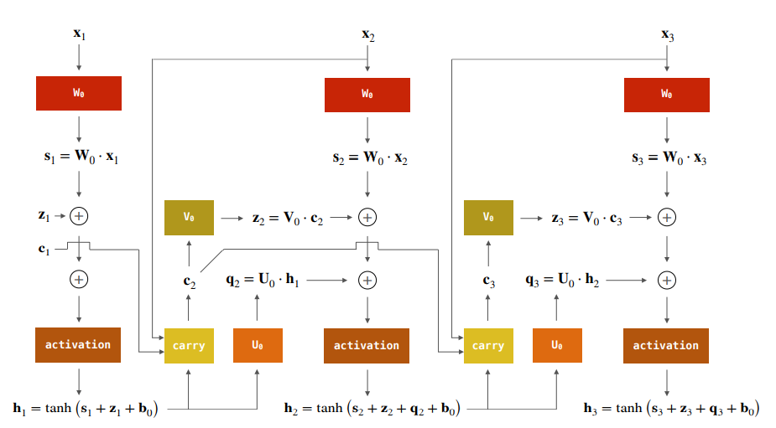
Univariate LSTM
Long Short-Term Memory (LSTM) networks are a type of recurrent neural network capable of learning order dependence in sequence prediction problems.
LSTM layer
Input
LSTM unit
LSTM Layer 1
//
LSTM Layer n
Dropout Layer
Dense Layer
Notes:
Long Short-Term Memory (LSTM) networks are a type of recurrent neural network capable of learning order dependence in sequence prediction problems. LSTM networks combat the RNN's vanishing gradients In ignoring useless information in the network through the implementation of a ‘forget’ gateThe basic model architecture that we are training comprises of 3 different layers: LSTM, Dropout and Dense. The LSTM Layer processes the sequential COE prices and passes the output values to the Dense Layer which only has one hidden unit as we are training the model to predict the COE price for the next time step only. The Dropout Layer is used to ‘deactivate’ random nodes in the LSTM Layer to reduce model overfitting.
LSTM diagram
NUS-ISS Pattern Recognition Using Machine Learning System, Module 7 - Solving Temporal Sequential Problems using Recurrent Neural Network
LSTM info: https://www.turing.com/kb/recurrent-neural-networks-and-lstm

Slide 20
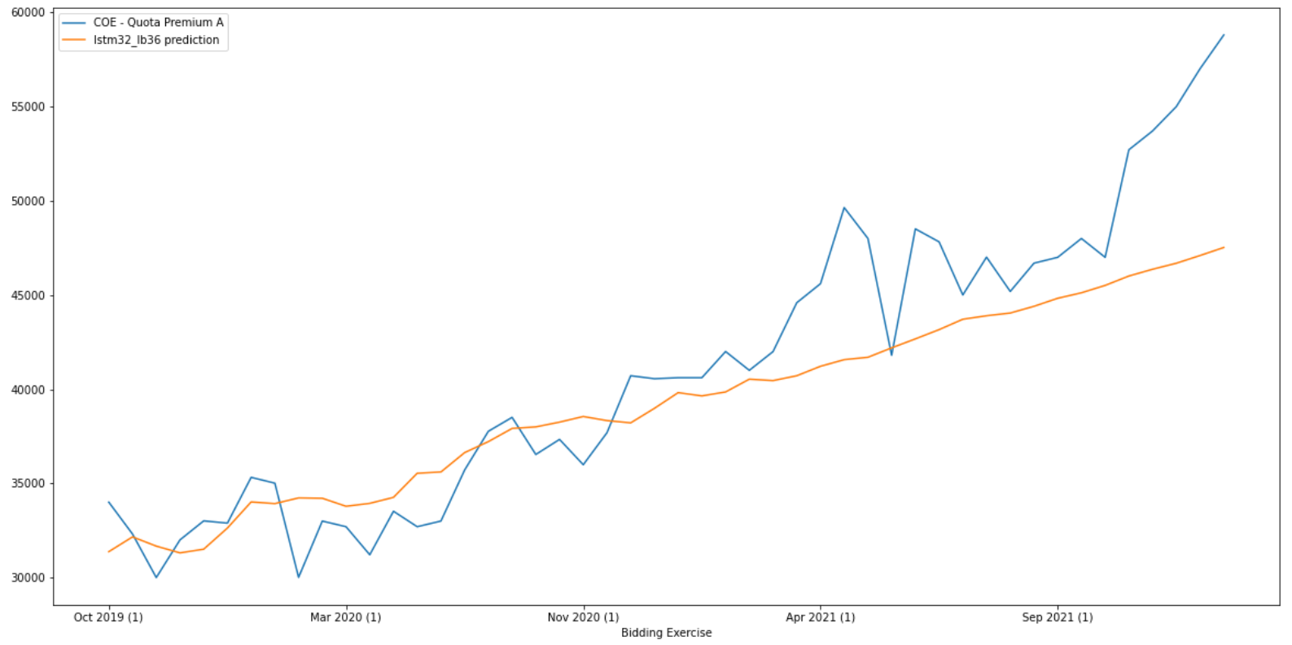
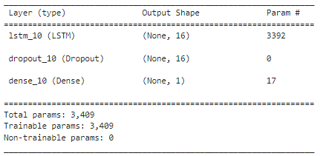
Univariate single-layer LSTM
Segment parameters:
length=36,
distance =36,
look_back/width=36
feature_count = 1
Hyperparameters:
batch_size = 4
Dropout = 0.2
Metric | Value
MAE | 3844.37
RMSE | 2787.80
MAPE | 6.27%
Activation function used for LSTM is ReLU
Method of Forecasting:
Single Step (Forward Walking)
Notes:
There are multiple parameters to tune for LSTM, which includes, segment length, segment distance, segment width, number of LSTM layers, number of hidden units per layer, activation function used and batch_size. For a single-layer univariate LSTM model, we trained several models using different combination of parameter values. After several iterations, the best single-layer univariate LSTM model that we have trained significantly outperforms all previous models, with a low MAPE of 6.27%, which is very apparent by looking at the relatively small differences between the forecasted values versus the actual values
LSTM diagram
NUS-ISS Pattern Recognition Using Machine Learning System, Module 7 - Solving Temporal Sequential Problems using Recurrent Neural Network

Slide 21
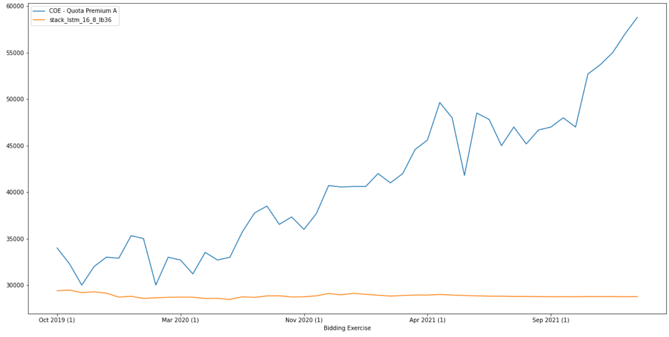
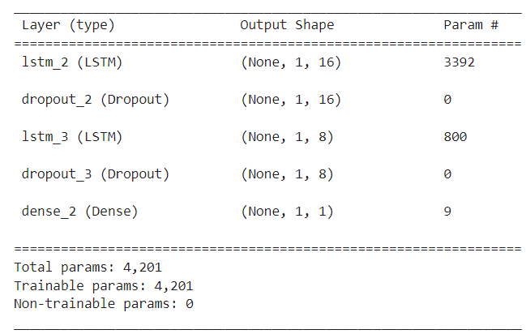
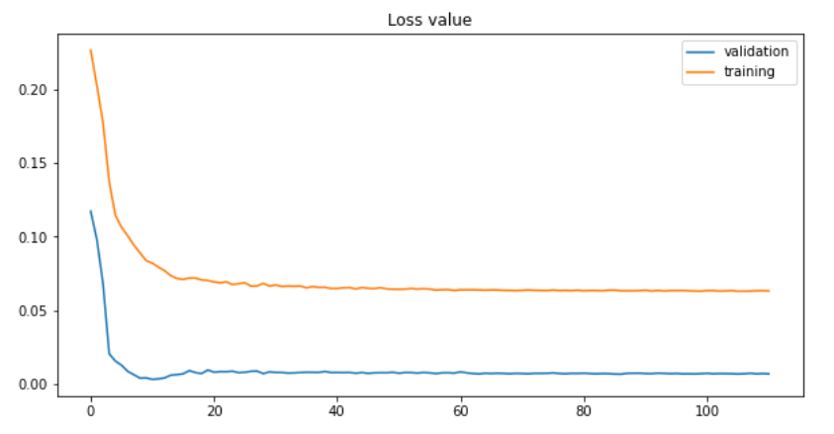
Univariate stacked LSTM
Segment parameters:
length=36,
distance =36,
look_back/width=36
feature_count = 1
Hyperparameters:
batch_size = 32,
Dropout = 0.2
Metric | Value
MAE | 14294.1
RMSE | 12126.93
MAPE | 27.25%
Activation function used for LSTM is ReLU
Method of Forecasting:
Single Step (Forward Walking)
Notes:
There are multiple parameters to tune for LSTM, which includes, segment length, segment distance, segment width, number of LSTM layers, number of hidden units per layer, activation function used and batch_size. For a single-layer univariate LSTM model, we trained several models using different combination of parameter values. After several iterations, the best single-layer univariate LSTM model that we have trained significantly outperforms all previous models, with a low MAPE of 6.27%, which is very apparent by looking at the relatively small differences between the forecasted values versus the actual values
LSTM diagram
NUS-ISS Pattern Recognition Using Machine Learning System, Module 7 - Solving Temporal Sequential Problems using Recurrent Neural Network

Slide 22
Model Comparison
 | Models
Metric | ARIMA | SARIMA | Holt-Winters (Single HWES) | Holt-Winters (Double HWES-1) | Holt-Winters (Double HWES-2) | Holt-Winters (Triple HWES) | RNN | Single-Layer LSTM | Stacked LSTM
MAE | 21174.30 | 11439.19 | 6433.00 | 13258.89 | 7889.79 | 11718.44 | 9779.10 | 3844.37 | 14294.10
RMSE | 17583.81 | 9810.83 | 7685.80 | 16369.56 | 10183.34 | 14634.92 | 12074.98 | 2787.80 | 12126.93
MAPE | 29.56% | 22.76% | 15.44% | 29.21% | 17.13% | 25.79% | 21.37% | 6.27% | 27.25%
Notes:
ARIMA Definition
https://www.sciencedirect.com/topics/mathematics/autoregressive-integrated-moving-average
https://www.machinelearningplus.com/time-series/arima-model-time-series-forecasting-python/

Slide 23
Multivariate Machine Learning

Slide 24
Data Collection and Preparation
The COE dataset (base dataset) and other datasets which might help in our prediction are collected:
Dataset | Description | Frequency | Year
COE | COE Bidding Result for Vehicle Category A to E | Bi-monthly | 2002 – 2022
Household Income | Average and Median Monthly Household Income from Work Among Resident and Resident Employed Households (per household and per household member) | Yearly | 2000 - 2021
GDP | Gross Domestic Product At Current Market Prices and By Industry | Yearly | 1960 - 2021
Public Transport | Public Transport Operation And Ridership (Bus, MRT, LRT) | Yearly | 1990 - 2021
PDI | Personal Disposable Income and Personal Saving | Quarterly | 1980 – 2022
Household Net Worth | Household Net Worth, Assets and Liabilities | Quarterly | 1995 – 2022
CPI | Consumer Price Index and Inflation Rates | Monthly | 1990 – 2022
Oil Price | Crude Oil WTI Futures Data | Weekly | 2002 – 2022
Notes:
Other than the COE dataset, we have also collected some other datasets which we feel might be helpful for the prediction. These ranges from economic indicators such as GDP to public transport ridership.

Slide 25
Data Collection and Preparation
As the datasets are of different frequencies and date range, we have decided on the following strategies to clean and merge the datasets into one master dataset for subsequent use:
In the base COE dataset, assign the first and second bidding result to 1st and 15th of each month respectively
Up sample datasets with yearly, quarterly or monthly frequencies to bi-monthly (1st and 15th of each month) and fill the missing values using the same value within the same year, quarter or month
Down sample datasets with weekly frequencies to bi-monthly taking the first entry that is closest to the 1st and 15th of each month
Merge the datasets using a ‘left join’ to the base COE dataset
Notes:
As the datasets are of different frequencies and date range we have decided to use the following strategies to clean and merge the datasets for subsequent use.
For COE dataset, assign the first and second bidding result to 1st and 15th of each month.
Next we then upsample or downsample the remaining datasets to bi-monthly, filling the missing values with either the same value throughout the month or year or take the entry that is closest to the 1st and 15th of the month.
Finally we merge the datasets to the base COE dataset using a left join.

Slide 26
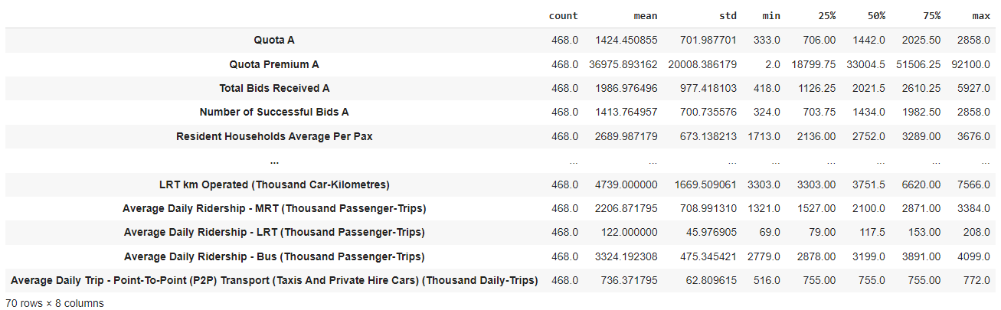
Data Exploration
The resulting merged (master) dataset contains 468 rows and 70 columns*
*excludes features specific to other categories (i.e. B,C,D,E)
Notes:
The resultant dataset contains 468 rows and 70 columns and the summary statistics are shown in the table.

Slide 27
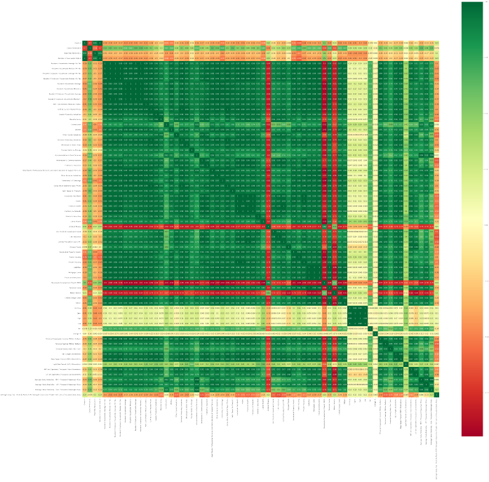
Data Exploration
The pairwise correlation heatmap shows that there are quite number of highly correlated features which suggest that we could apply dimension reduction as our next step
Notes:
A plot of the correlation heatmap shows quite a number of highly correlated features which suggest that we could apply dimension reduction as the next step.

Slide 28
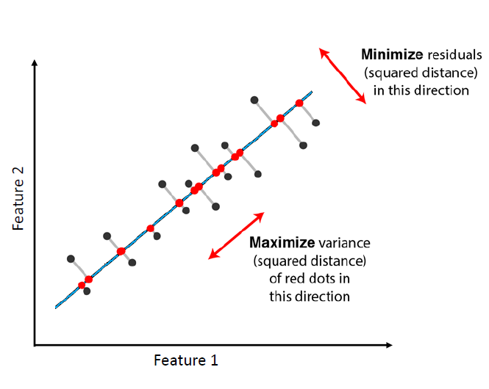
Principal Component Analysis
Principal Component Analysis (PCA) is a technique that transforms data from a high dimension space into a lower dimension space while preserving as much information as the original data as possible. This is achieved by finding a new axis that captures the maximum variance within the data once it is projected onto the new axis.
Notes:
Principal Component Analysis is a technique that transforms data from a high dimension space into a lower dimension space while preserving as much information as the original data as possible. This is achieved by finding a new axis that captures the maximum variance within the data once it is projected onto the new axis.
Diagram: NUS-ISS Problem Solving using Pattern Recognition, Day 3: Dimensionality Reduction

Slide 29
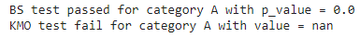
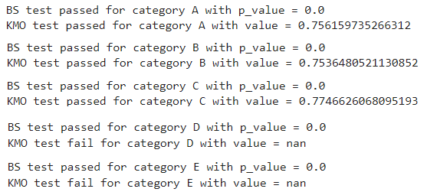
Dimension Reduction with PCA
Barlett’s Sphericity (BS) test & Kaiser-Meyer-Olkin (KMO) test was conducted to find out whether the resulting dataset is suitable for PCA.
Test result (include target column ‘Quota Premium A’):
Test result (exclude target column ‘Quota Premium A’):
Thus, we decided to perform PCA by excluding the ‘Quota Premium A’ column.
Notes:
Barlett's Sphericity and KMO tests are carried out to find out whether the dataset is suitable for PCA and the results are as shown.
Since the dataset excluding 'Quota Premium A' passes both tests, we'll perform PCA on the dataset excluding 'Quota Premium A'.

Slide 30
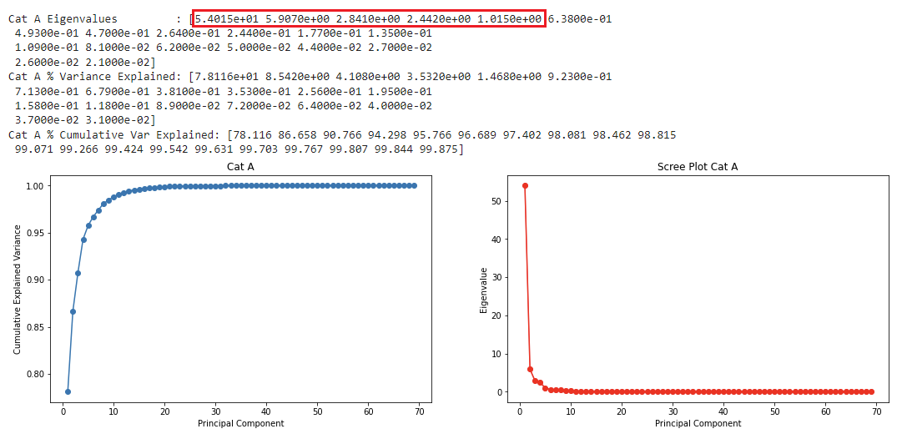
Dimension Reduction with PCA
According to Kaiser Rule, principal component eigenvalue should be > 1 and this suggest that the number of principal components we could use should be <= 5.
Since 1 or 2 principal components can explain around 78% - 86% of the variance, we decided to try out with 1 to 2 principal components.
Notes:
According to Kaiser Rule, principal component eigenvalue should be greater than 1 and this suggest that the number of principal components we could use should be less than or equals to 5.
Since 1 or 2 principal components can already explain around 78% - 86% of the variance, we decided to try out with 1 to 2 principal components.

Slide 31
Inclusion of historical 'Quota Premium A' feature
As the historical values of the target ‘Quota Premium A’ could also provide useful contextual information, we also experiment with adding the standardised ‘Quota Premium A’ data as one of the lag feature when training the model using different LSTM architecture (single layer, stacked, bidirectional).
PC_1 | ... | PC_n | Lag feature Quota Premium A (standardised)
x.xxx | ... | x.xxx | x.xxx
⁞ | ⁞ | ⁞ | ⁞
Sample illustration of adding 'Quota Premium A' data to the feature set
Notes:
As the historical 'Quota Premium A' data could also provide useful contextual information, we also experiment with adding the standardised ‘Quota Premium A’ data as one of the lag feature when training the model using different LSTM architecture namely single layer LSTM, stacked LSTM and bi-directional LSTM.

Slide 32
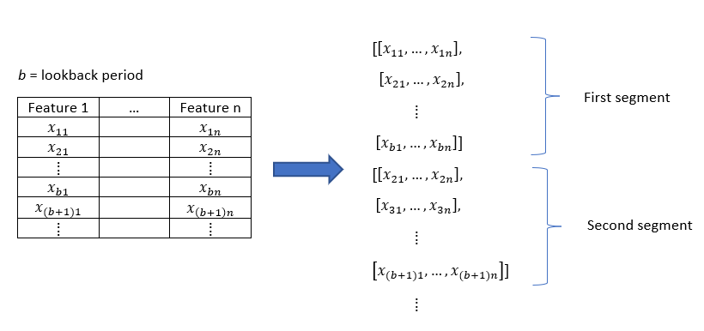
Segment Preparation
The feature set is split into segments for input into the model for training.
Each segment having shape (b, n), where b is the “lookback” period and n is the number of features.
Notes:
The feature set is split into segments for input into the model for training. Each segment having shape (b, n), where b is the “lookback” period and n is the number of features.

Slide 33
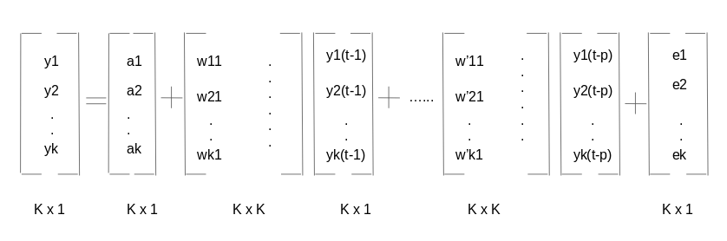
VARMA
VARMA = VAR (Vector Auto Regression) + VMA (Vector Moving Average)
Used for multivariate time series forecasting
Vector Auto Regression (VAR) is able to understand and use the relationship between several variables, unlike AR used in ARIMA and SARIMA. In a VAR model, each variable is a linear function of the past values of itself and the past values of all the other variables:
The Vector Moving Average(VMA) model is a generalization of the Moving Average (MA) Model for multivariate time series where the time series is stationary
Notes:
VARMA definition
https://www.analyticsvidhya.com/blog/2018/09/multivariate-time-series-guide-forecasting-modeling-python-codes/
https://analyticsindiamag.com/a-guide-to-varma-with-auto-arima-in-time-series-modelling/
VARMA Implementation
https://www.tutorialspoint.com/time_series/time_series_variations_of_arima.htm

Slide 34
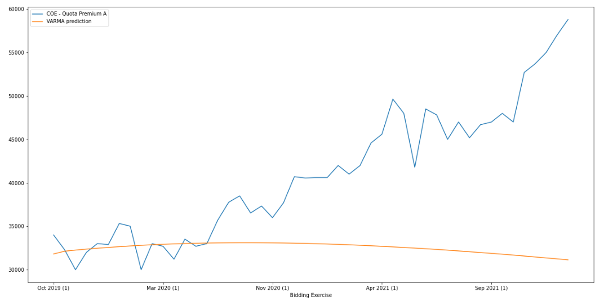
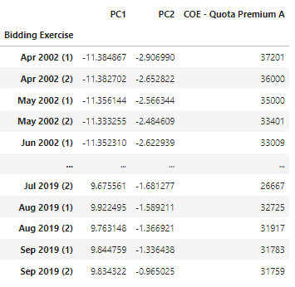
VARMA
Number of PCs used = 2
Metric | Value
MAE | 11603.73
RMSE | 8790.22
MAPE | 18.94%
Model predictions are very close to the actual values for the first 1/3 of the test set but starts to diverge as the bidding exercises progresses
Notes:
VARMA definition
https://www.analyticsvidhya.com/blog/2018/09/multivariate-time-series-guide-forecasting-modeling-python-codes/
https://analyticsindiamag.com/a-guide-to-varma-with-auto-arima-in-time-series-modelling/
VARMA Implementation
https://www.tutorialspoint.com/time_series/time_series_variations_of_arima.htm

Slide 35
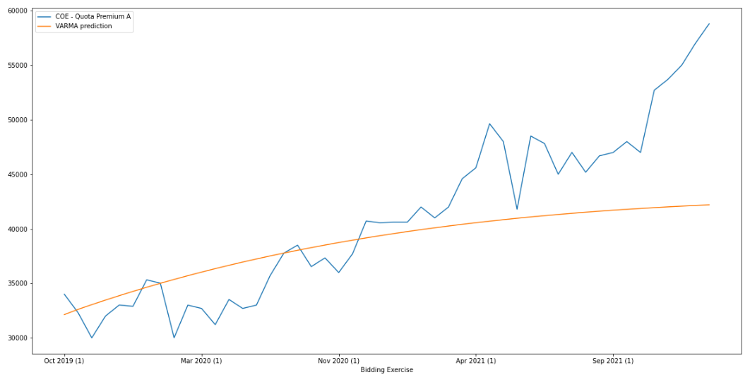
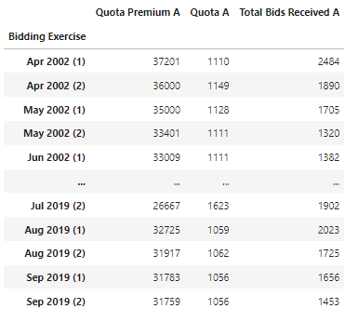
VARMA
Hand-picked features
Metric | Value
MAE | 5655.44
RMSE | 4125.50
MAPE | 9.26%
Model performance improved significantly after feature set has been changed from principal components to manually selected features which include ‘Quota A’ and ‘Total Bids Received A’
Notes:
VARMA definition
https://www.analyticsvidhya.com/blog/2018/09/multivariate-time-series-guide-forecasting-modeling-python-codes/
https://analyticsindiamag.com/a-guide-to-varma-with-auto-arima-in-time-series-modelling/
VARMA Implementation
https://www.tutorialspoint.com/time_series/time_series_variations_of_arima.htm

Slide 36
Experimentation with multivariate LSTM
The following model naming convention is used to indicate the different parameters used when training the model.
For example:
lstm256_pc1_lb48_lag
stack_lstm128_64_32_pc2_lb48
Single-layer
LSTM with 256 units
1 principal component
lookback period 48
lag feature (Quota Premium A) included
Stacked LSTM with 1st layer 128 units,
2nd layer 64 units,
3rd layer 32 units
2 principal components
lookback period 48
Absent of the “lag” portion indicates that lag feature (Quota Premium A) is not included
bidirectional_lstm128_pc2_lb36_lag_ave
Bi-directional
LSTM with forward/backward layer 128 units
2 principal component
lookback period 36
lag
feature included
Merge mode = 'ave', absent of this portion indicates default 'concat' is used
Notes:
We adopted the following model naming convention when experimenting with multivariate LSTM to help us keep track of the parameters used when trying out the different combinations.
The experiment is conducted with over 50 different combinations and the best model of the respective LSTM is shown in the next few slides.

Slide 37
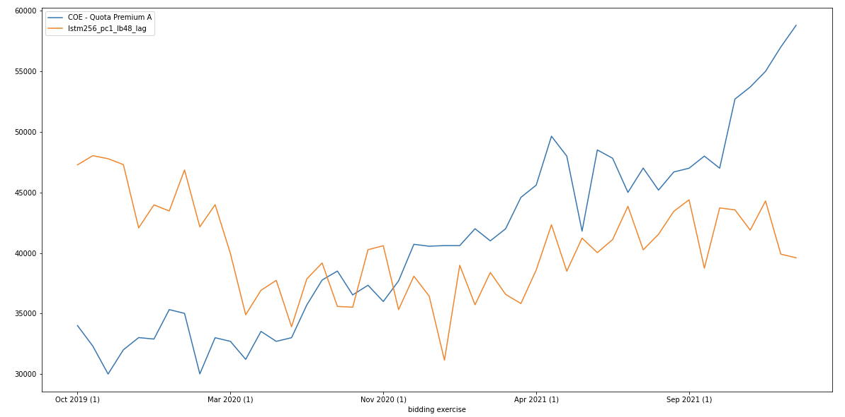
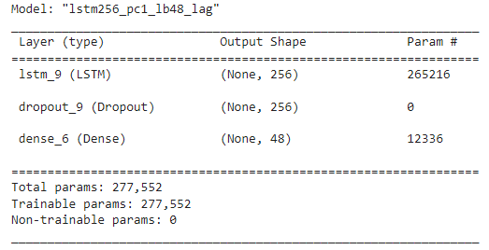
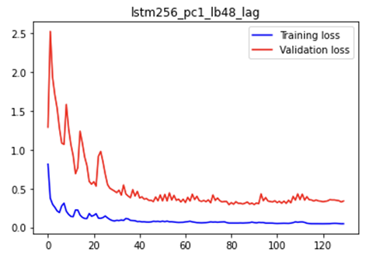
LSTM (Single layer)
Model name: lstm256_pc1_lb48_lag
Feature count = 2
Activation function: tanh
Metric | Value
MAE | 7114.61
RMSE | 8614.47
MAPE | 17.16%
Method of Forecasting:
Multi step (single shot)
Notes:
Multivariate single layer LSTM did not manage to outperform univariate single layer LSTM. Thus, we try to add more layers to see if the performance can be improved.

Slide 38
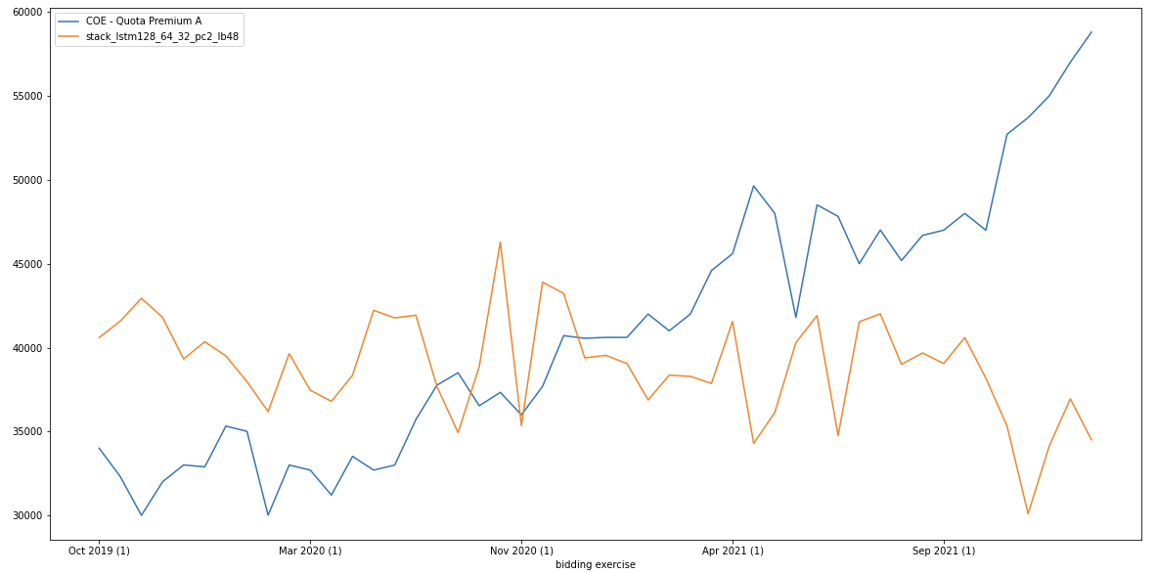
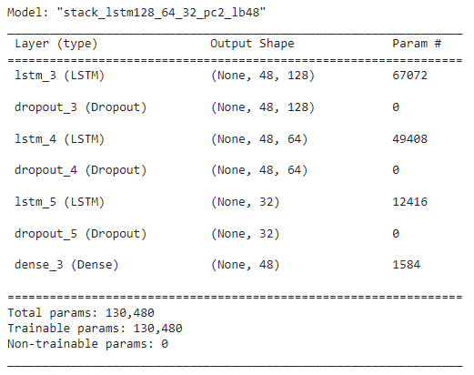
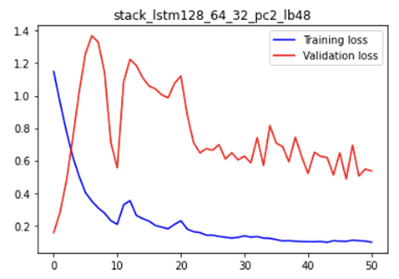
Stacked LSTM
Model name: stack_lstm128_64_32_pc2_lb48
Feature count = 2
Activation function: tanh
Metric | Value
MAE | 7558.98
RMSE | 9507.52
MAPE | 16.22%
Method of Forecasting:
Multi step (single shot)
Notes:
However, adding additional layers does not have significant improvement on the performance. So we'll proceed to try out bi-directional LSTM.

Slide 39
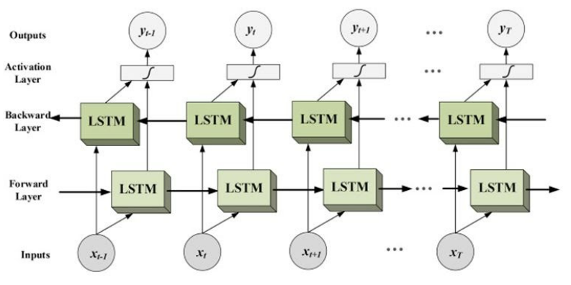
Bi-directional LSTM
Bi-directional LSTM is a variant of LSTM where the model learns the input sequence in both the forward and backward direction
This allows preservation of information from the past and the future which potentially add important context to the prediction making process
Source: https://analyticsindiamag.com/complete-guide-to-bidirectional-lstm-with-python-codes/
Notes:
Bi-directional LSTM is a variant of LSTM where the model learns the input sequence in both the forward and backward direction.
This allows preservation of information from the past and the future which potentially add important context to the prediction making process.

Slide 40
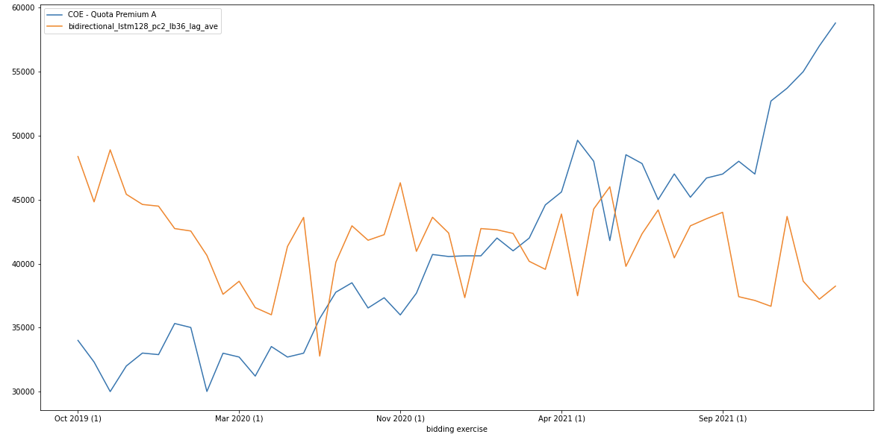
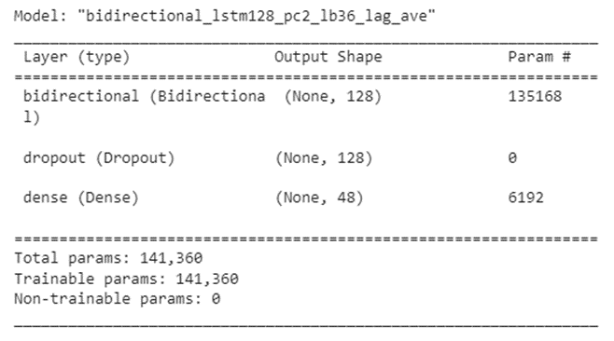
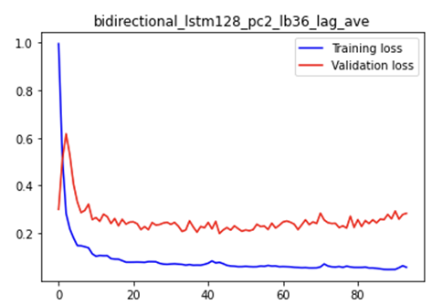
Bi-directional LSTM
Model name: bidirectional_lstm128_pc2_lb36_lag_ave
Feature count = 3
Merge mode: ave
Activation function: tanh
Metric | Value
MAE | 7358.82
RMSE | 9061.10
MAPE | 17.37%
Method of Forecasting:
Multi step (single shot)
Notes:
Bi-directional LSTM does not perform better than single layer or stacked LSTM.

Slide 41
Model Comparison (Multivariate)
 | Models
Metric | VARMA | Single-Layer LSTM | Stacked LSTM | Bi-directional LSTM
MAE | 5655.44 | 7114.61 | 7558.98 | 7358.82
RMSE | 4125.50 | 8614.47 | 9507.52 | 9061.10
MAPE | 9.26% | 17.16% | 16.22% | 17.37%

Slide 42
Model Comparison (All)
 | Models |  |  |  |  |  |  |  |  | Models
 | Univariate |  |  |  |  |  |  |  |  | Multivariate
Metric | ARIMA | SARIMA | Holt-Winters (Single HWES) | Holt-Winters (Double HWES-1) | Holt-Winters (Double HWES-2) | Holt-Winters (Triple HWES) | RNN | Single-Layer LSTM | Stacked LSTM | VARMA | Single-Layer LSTM | Stacked LSTM | Bi-directional LSTM
MAE | 21174.30 | 11439.19 | 6433.00 | 13258.89 | 7889.79 | 11718.44 | 9779.10 | 3844.37 | 14294.10 | 5655.44 | 7114.61 | 7558.98 | 7358.82
RMSE | 17583.81 | 9810.83 | 7685.80 | 16369.56 | 10183.34 | 14634.92 | 12074.98 | 2787.80 | 12126.93 | 4125.50 | 8614.47 | 9507.52 | 9061.10
MAPE | 29.56% | 22.76% | 15.44% | 29.21% | 17.13% | 25.79% | 21.37% | 6.27% | 27.25% | 9.26% | 17.16% | 16.22% | 17.37%

Slide 43

Model Comparison (All)

Slide 44


End Product - iCARe Web Application

Slide 45
Future Work
Time series forecasting models used for the forecasting of COE Category A prices can be extended to all the other COE categories (B, C, D and E).
Model performance is also a potential area of improvement by experimenting with even more combinations of model hyperparameters and through experimenting with more advanced deep learning models such as attention mechanism models.
Web application functionality can also be expanded to embed links to car dealers’ websites for users to explore and purchase the cars at promotional prices.
Implement a web crawler that automatically search the web for the latest car models and prices and automatically updates the car database.
Forecasting models to be re-trained on new data using an automated script after every COE bidding exercise.

Slide 46
Conclusion
Successfully built a web application which is able to predict future COE prices and provide recommendations based on users’ preferences and budget.
Trained several models and optimizing the model performance by tweaking the models’ hyperparameters and input feature set.
Final forecasting model selected and embedded in the application’s backend is capable of predicting future prices with relatively high confidence, having a reasonably low mean absolute percentage error (MAPE) of 6.27%.
Backend system interfaced seamlessly with the frontend system, rendering the model predictions and list of recommended cars on the web interface with minimal latency.

